Slide 1
Advanced Database Topics InfluxDB "Time keeps flowing like a river to the sea" - Alan Parsons Project
Notes:
Replace this with your course title and your name/contact details.

Slide 2
The importance of time
More electronic devices than ever before are connected to the internet, phones, watches, sensors, cars, TVs, and so on. Strong use case for IoT
These devices generate enormous amounts of new, unstructured real-time data every minute.
Analyzing time-structured data has become the most important problem across many industries.
Many companies are looking for a new way to solve their time-series data problems and have utilized their available influx data.
As a result, the popularity of the time-series database has rapidly increased over the past few years.

Slide 3
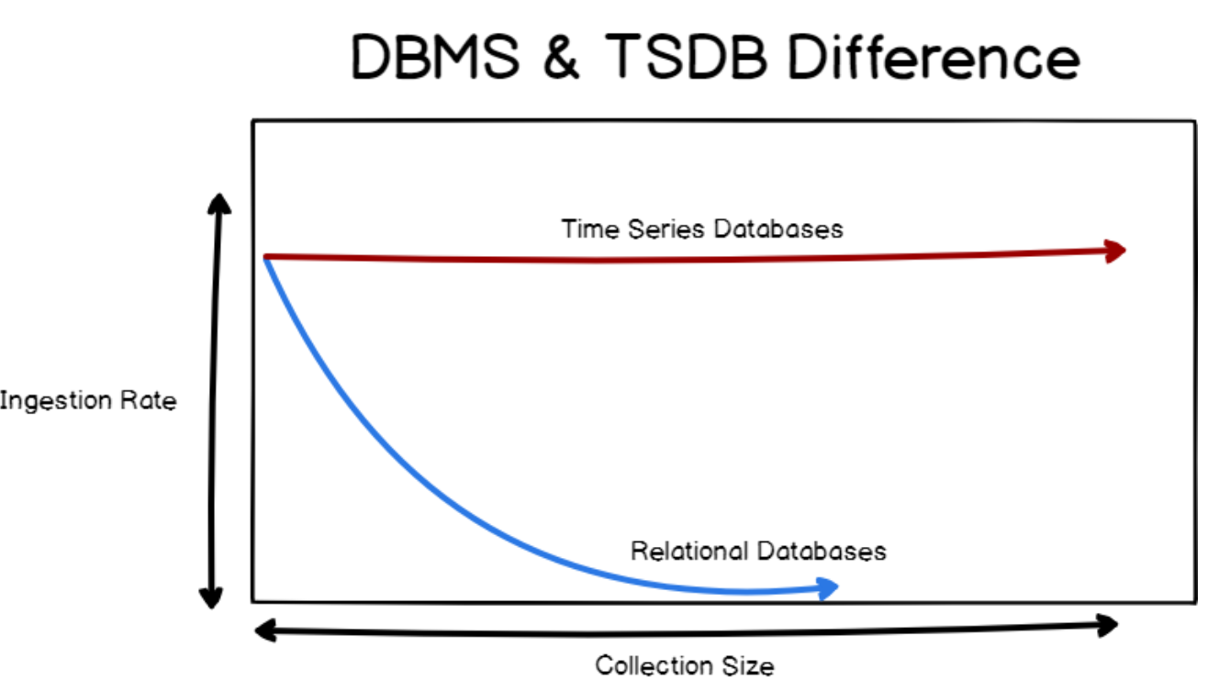
But why not relational
For every point that you are able to store, you have a timestamp associated with it.
But couldn't a relational database have a timestamp column? Why a special class of databases?
Fast ingestion rate: Time series databases systems are built around the predicate that they need to ingest data in a fast and efficient way.
Relational databases do have a fast ingestion rate for most of them, from 20k to 100k rows per second. However, the ingestion is not constant over time. RDBMS have indexes.
Time series database are optimized for a fast ingestion rate. It means that such index systems are optimized to index data that are aggregated over time.
Ingestion rate does not decrease over time and stays quite stable, around 50k to 100k lines per second on a single node.

Slide 4
But why not relational?
Time series databases work differently. Data are still stored in ‘collections’ but those collections share a common denominator: they are aggregated over time.
A time series database is a storage technique that is designed to be fast at both storing and retrieving points of data.
You can measure CPU usage in percentiles from one second to the next or alternatively measure the number of times a particular service call has been made.
Once you have a different series, you can start to use this data for correlation.
For example, we can record CPU statistics across the service call information and start noting where the CPU spikes correlate with the service calls.

Slide 5
InfluxDB Constructs
Measurement acts as a container for tags, fields, and the time column; the measurement name is the description of the data stored in the associated fields.
Tags vs Fields
InfluxDB lets you specify fields and tags, both being key/value pairs where the difference is that tags are automatically indexed.
Because fields are not being indexed at all, on every query where InfluxDB is asked to find a specified field, it needs to sequentially scan every value of the field column (like relational full table scans)
Retention policy (RP)
Describes how long InfluxDB keeps data (duration), how many copies of the data to store in the cluster (replication factor), and the time range covered by shard groups (shard group duration). RPs are unique per database and along with the measurement and tag set define a series.
When you create a database, InfluxDB creates a retention policy called autogen with an infinite duration, a replication factor set to one, and a shard group duration set to seven days. For more information, see Retention policy management.

Slide 6

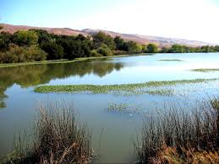
NOAA Water Database
The sample database loaded into Influx is the NOAA water Database which examines water quality in Santa Monica and the Coyote Creek
Water data from August 17, 2019 to September 17, 2019

Slide 7
InfluxQL: USE and SHOW
USE – sets current DB
SHOW – browse the database
> show databases
name: databases
name
----
_internal
NOAA_water_database
demodb
> show measurements
name: measurements
name
----
average_temperature
h2o_feet
h2o_pH
h2o_quality
h2o_temperature
Why do you think NOAA made the field / tag choices they did?
> show field keys
name: average_temperature
fieldKey fieldType
-------- ---------
degrees float
name: h2o_feet
fieldKey fieldType
-------- ---------
level description string
water_level float
name: h2o_pH
fieldKey fieldType
-------- ---------
pH float
> show tag keys
name: average_temperature
tagKey
------
location
name: h2o_feet
tagKey
------
location
name: h2o_pH
tagKey
------
location

Slide 8
InfluxQL: more SHOW
> show retention policies
name duration shardGroupDuration replicaN default
---- -------- ------------------ -------- -------
autogen 0s 168h0m0s 1 true
Duration of 0s means data will be stored infinitely. The shard duration determines how much time each shard group spans.
> show series
key
---
average_temperature,location=coyote_creek
average_temperature,location=santa_monica
h2o_pH,location=coyote_creek
h2o_pH,location=santa_monica
Series: a logical grouping of data defined by shared measurement, tag set, and field key.

Slide 9
InfluxQL: SELECT
> select * from h2o_pH limit 5
name: h2o_pH
time location pH
---- -------- --
1566000000000000000 coyote_creek 7
1566000000000000000 santa_monica 6
1566000360000000000 coyote_creek 8
1566000360000000000 santa_monica 6
1566000720000000000 coyote_creek 8
> select location from h2o_feet limit 5
> select location, water_level from h2o_feet limit 5
name: h2o_feet
time location water_level
---- -------- -----------
1566000000000000000 coyote_creek 8.12
1566000000000000000 santa_monica 2.064
1566000360000000000 coyote_creek 8.005
1566000360000000000 santa_monica 2.116
1566000720000000000 coyote_creek 7.887
>
SELECT statements must include at least one field key

Slide 10
InfluxQL: Getting distinct values
> show tag values with key = randtag
name: h2o_quality
key value
--- -----
randtag 1
randtag 2
randtag 3
> show tag values from h2o_pH with key = location
name: h2o_pH
key value
--- -----
location coyote_creek
location santa_monica
> select distinct(pH) from h2o_pH
name: h2o_pH
time distinct
---- --------
0 6
0 7
0 8
For tags, you must use the SHOW command
First query shows across all measurements
Second query limits to a particular measurement.
For fields, you must use the SELECT command

Slide 11
Fully Qualified Measurements
Time series data by nature begins to pile up pretty quickly and it can be helpful to discard old data after it’s no longer useful.
Retention policies offer a simple and effective way to achieve this. It amounts to what is essentially an expiration date on your data. Once the data is “expired” it will automatically be dropped from the database, an action commonly referred to as retention policy enforcement.
An InfluxDB instance can have 1 or more databases.
Each of those databases can have 1 or more retention policies. (autogen is the default.)
To fully qualify a measurement, you can use database and retention policy and measurement
> select water_level from NOAA_water_database.autogen.h2o_feet limit 3
name: h2o_feet
time water_level
---- -----------
2019-08-17T00:00:00Z 8.12
2019-08-17T00:00:00Z 2.064
2019-08-17T00:06:00Z 8.005

Slide 12
InfluxQL: WHERE and GROUP BY
> select pH from h2o_pH where location='coyote_creek' and pH > 7 limit 3
name: h2o_pH
time pH
---- --
1566000360000000000 8
1566000720000000000 8
1566003600000000000 8
> select mean(water_level) from h2o_feet group by location
name: h2o_feet
tags: location=coyote_creek
time mean
---- ----
0 5.3591424203039155
name: h2o_feet
tags: location=santa_monica
time mean
---- ----
0 3.5307120942458807

Slide 13
InfluxQL: GROUP BY time interval
> select mean(water_level) from h2o_feet where location='santa_monica' group by time(15m)
name: h2o_feet
time mean
---- ----
1566000000000000000 2.0693333333333332
1566000900000000000 2.0835
1566001800000000000 2.0583333333333336
1566002700000000000 2.0225
> select mean(water_level) from h2o_feet where location='santa_monica' group by time(15m) limit 5
name: h2o_feet
time mean
---- ----
2019-08-17T00:00:00Z 2.0693333333333332
2019-08-17T00:15:00Z 2.0835
2019-08-17T00:30:00Z 2.0583333333333336
2019-08-17T00:45:00Z 2.0225
Same query, but influx started with -precision rfc3339 switch

Slide 14
InfluxQL: Miscellany
By default, InfluxDB orders by time ascending, but you can add an order by clause to reverse that
ORDER BY time DESC
OFFSETs work like MySQL
LIMIT 3, 5 in MySQL
LINIT 5 OFFSET 3 in Influx
> select first(pH), time from h2o_pH
name: h2o_pH
time first
---- -----
2019-08-17T00:00:00Z 7
> select last(pH), time from h2o_pH
name: h2o_pH
time last
---- ----
2019-09-17T21:42:00Z 7
To delete a measurement
DROP MEAASUREMENT <measurement-name>
Get first and last observations

Slide 15
Grafana

Slide 16
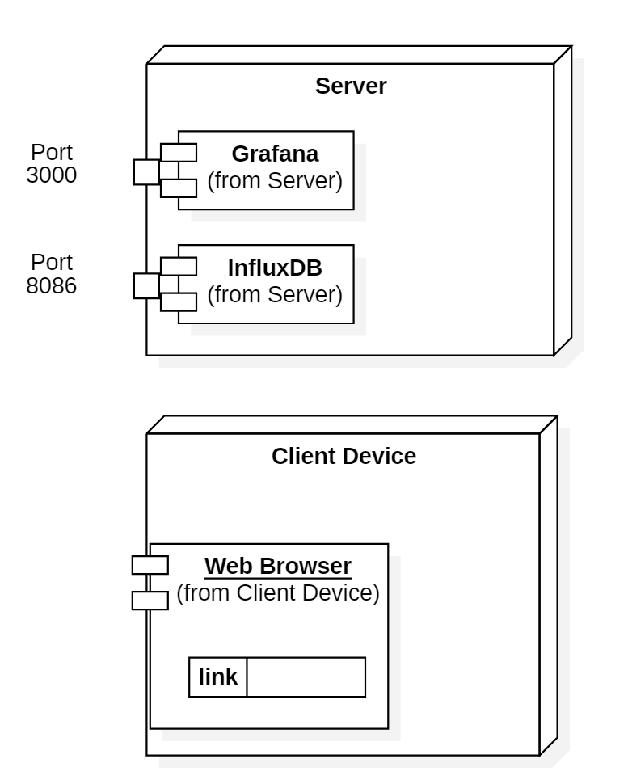
Grafana Architecture

Slide 17
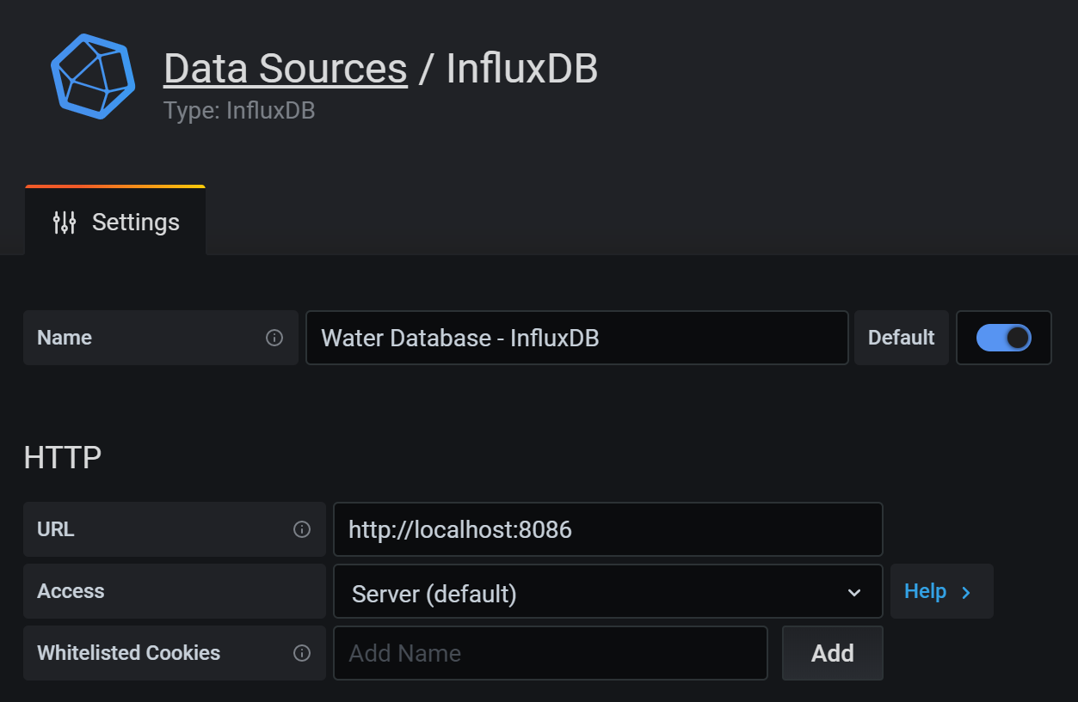
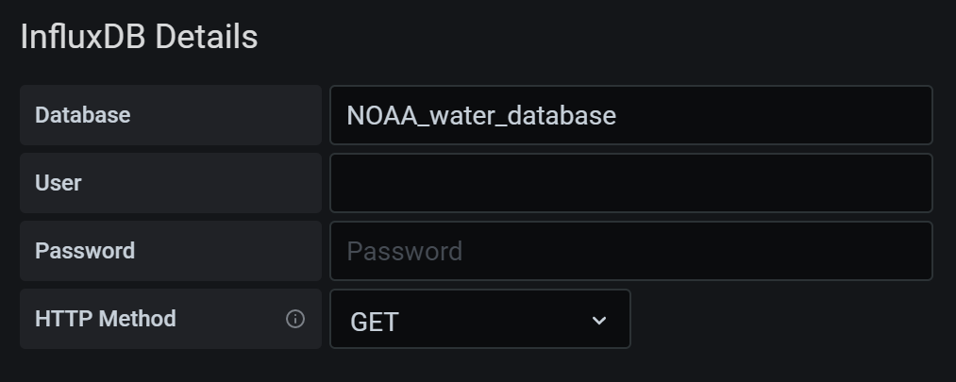
Grafana
Grafana is a multi-platform open source analytics and interactive visualization web application. It provides charts, graphs, and alerts for the web when connected to supported data sources.
From http://54.237.9.240:3003/

Slide 18
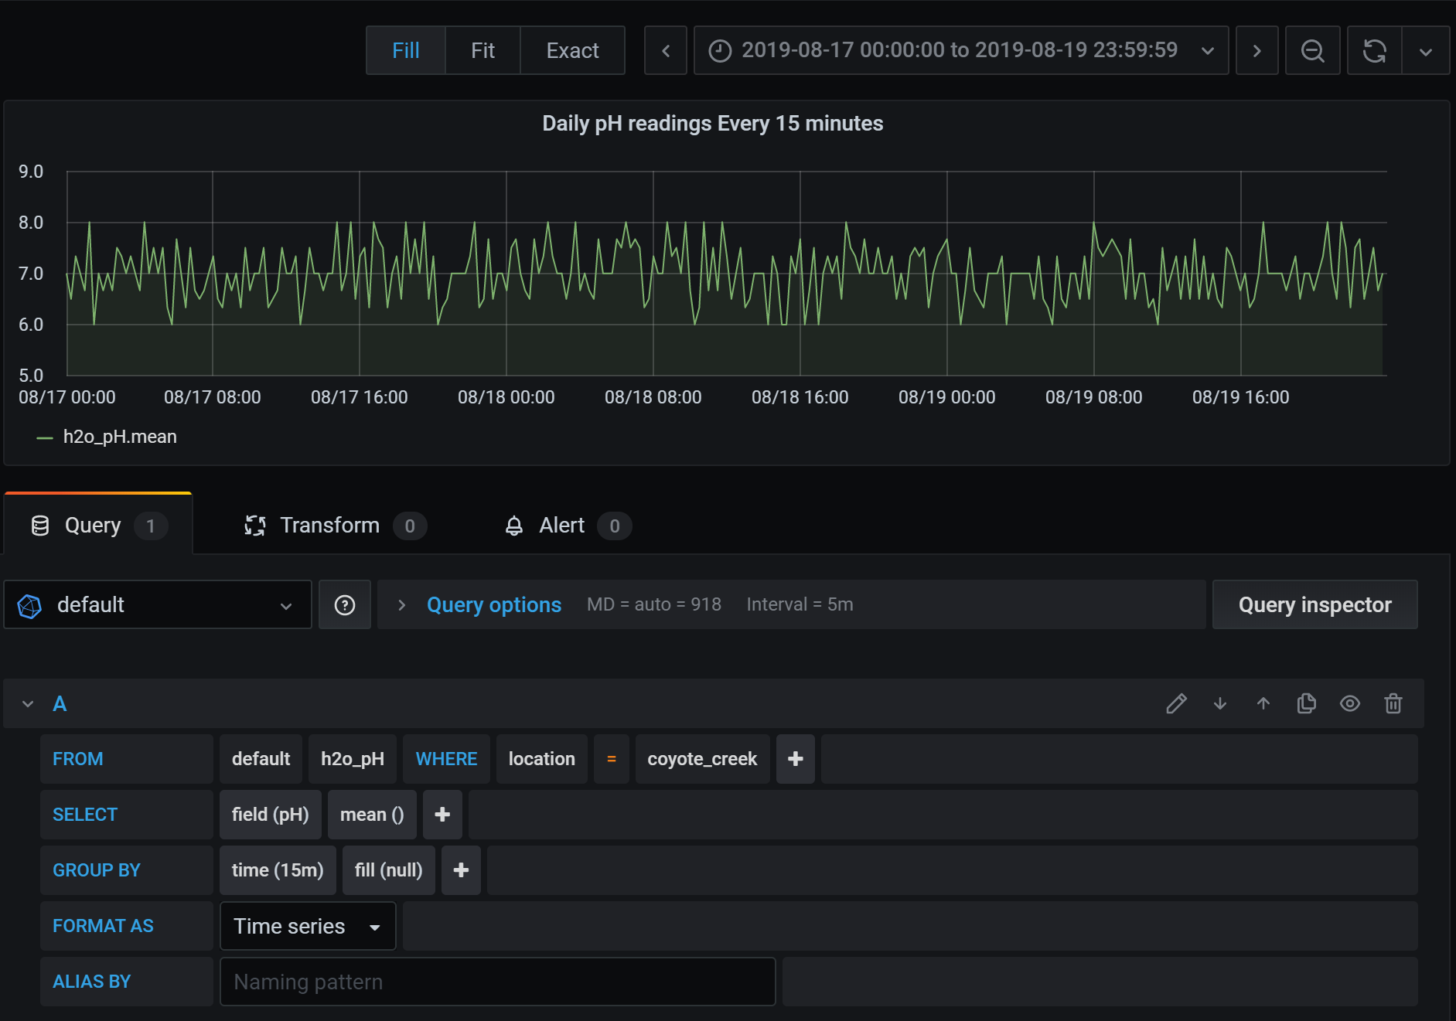
Grafana Dashboard
SELECT mean("pH") FROM "h2o_pH" WHERE ("location" = 'coyote_creek') AND $timeFilter GROUP BY time(15m) fill(null)
time range
measurement
query conditions

Slide 19
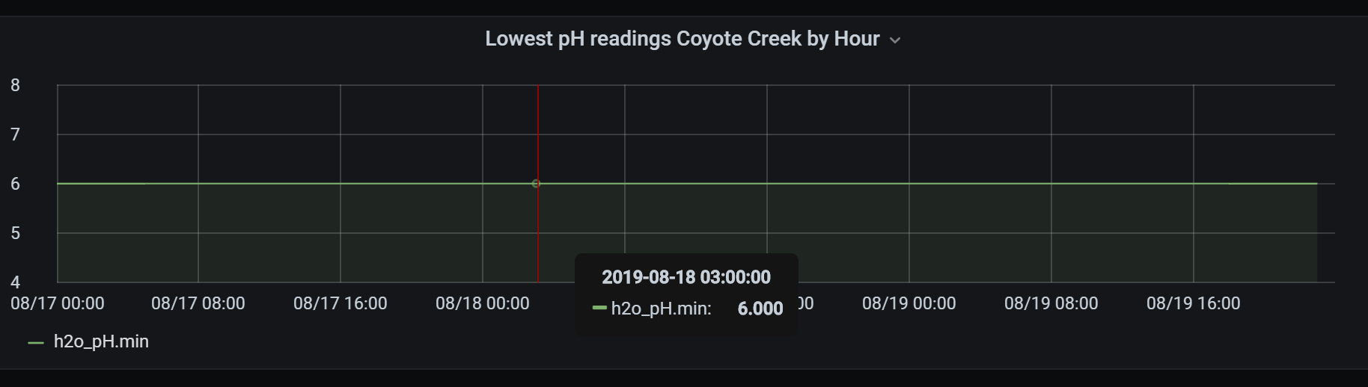
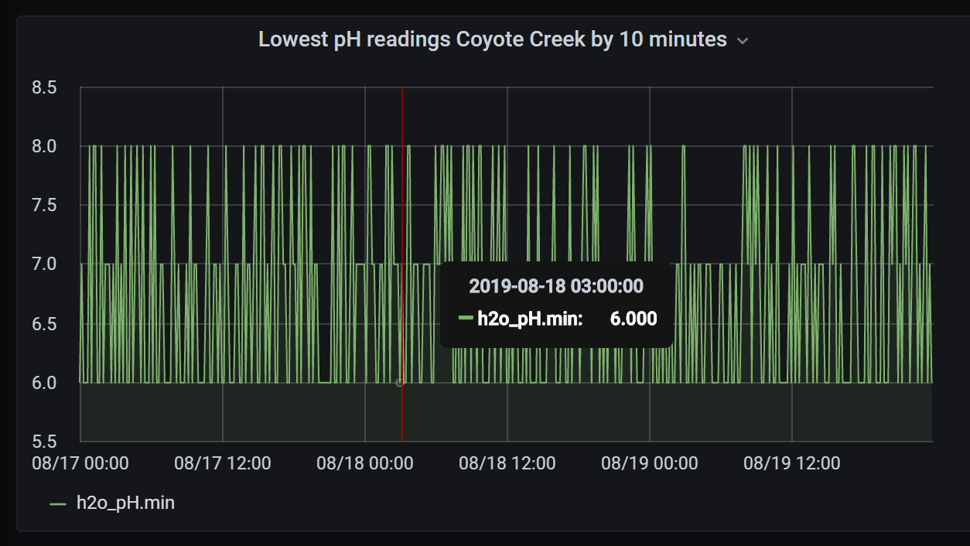
Use Grafana to Visualize Data

Slide 20
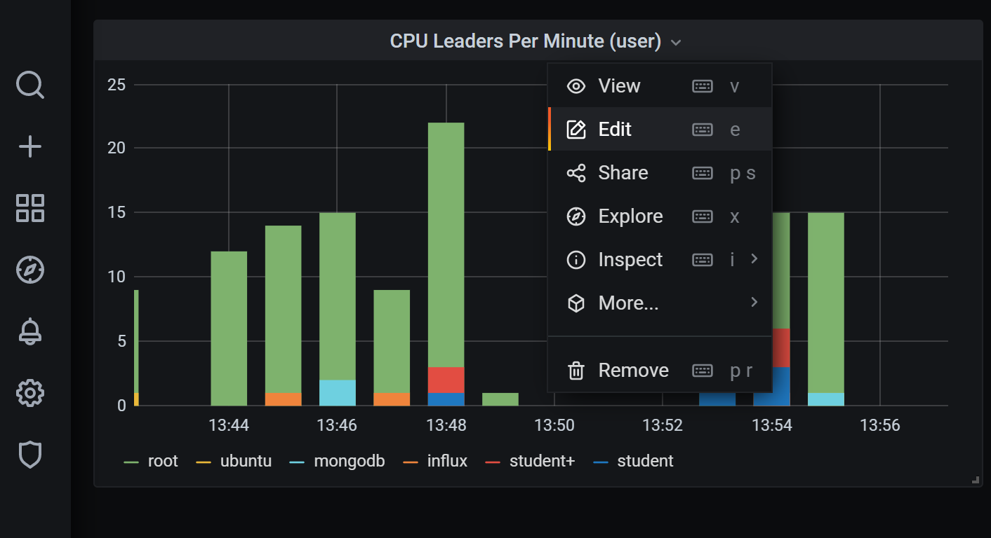
Editing a dashboard
Use the drop down menu next to the title of the dashboard

